Slide 1

MINFINDER : A NEW APPROACH IN SORTING ALGORITHM
Data Structures and Algorithm Case Study :

Slide 2
ABOUT THE PAPER
Paper Title : Min Finder : A New Approach in Sorting Algorithm
MinFinder: A New Approach in Sorting Algorithm - ScienceDirect
Published year : 2019
Authors : Md. Shohel Rana , Md Altab Hossinb , S M Hasan Mahmud, Hosney Jahan ,
A. K. M. Zaidi Satter , Touhid Bhuiyan

Slide 3

CONTENT
Introduction
Sorting Categories
Different Sorting Algorithms
Min Finder Sorting Algorithm
Complexity Analysis
Conclusion
Types of sorting algorithms while developing a new algorithm for sorting task
Properties of Sorting Algorithms
Standards for Selecting Sorting Algorithm
Performance Result

Slide 4

INTRODUCTION
Sorting is the re-arrangement of elements into either ascending or descending order within the array.
Sorting also helps in reducing the Time complexity of algorithm
This is where different types of sorting algorithms comes into play. It not only saves our time, but also provides with right solution.
This paper proposed a new sorting algorithm to overcome some of the downsides and performs better compared to some conventional algorithms in terms of stability, complexity etc.

Slide 5
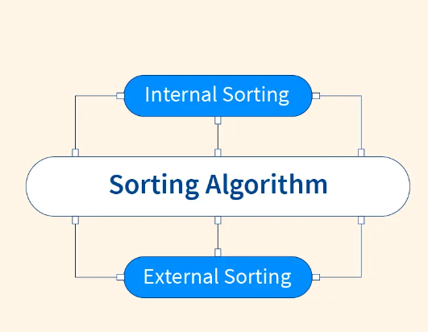
SORTING CATEGORIES

Slide 6
INTERNAL SORTING
It put data in such a way that, it can be adjusted in main memory at ones.
Algorithms used for internal sorting are : Insertion sort , Selection sort, Heap sort, Bubble sort, Quick Sort etc..
If the data collection is too big to fit in the main memory, then sorting cannot be completed in main memory alone.
It need to be store in hard disc, floppy disc or any other storage devices. This technique is called External Sorting
EXTERNAL SORTING

Slide 7
DIFFERENT SORTING ALGORITHMS
Bubble Sort
Selection Sort
Insertion Sort
Merge Sort
Quick Sort
Counting Sort
Radix Sort
Bucket Sort
Heap Sort
Shell Sort

Slide 8
Types of sorting algorithms while developing a new algorithm for sorting task
In-place Sorting: The program does not require any extra space for comparison. (E.g. bubble sort)
Not-in-place Sorting: Sorting which uses equal or more space (E.g. merge sort)
Stable Sorting: maintains the relative order of the items with equal sort keys. (Eg:Insertion Sort)
Not Stable Sorting: Alternates the sequence of similar item in which they appear after sorting the items. (Eg: Quick sort)
Adaptive Sorting: Takes advantage of already 'sorted' items, which means don’t try to re-order them into sorted form while the items has already sorted. (Eg: Straight Insertion Sort)
Non-Adaptive Sorting: Try to force every single item to be re-ordered by confirming their sortedness. (Eg: Heap sort)

Slide 9


Properties of Sorting Algorithms
Input
Output
Definiteness
Correctness
Finiteness
Effectiveness
Generality

Slide 10
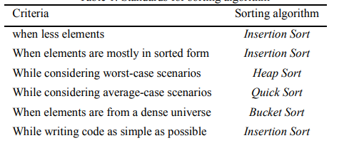
Standards for Selecting Sorting Algorithm

Slide 11
MINFINDER SORTING ALGORITHM
The algorithm mainly finds the element whose value is smallest from the list or array and place it to the first position of the list or array by shifting elements one position to the right from the first position to the position of smallest element found.
Then find the second smallest element and place to the second position using same technique.
This technique continues until all the unsorted elements place in the proper position of array.
It sort elements within same array without using extra memory or space.

Slide 12
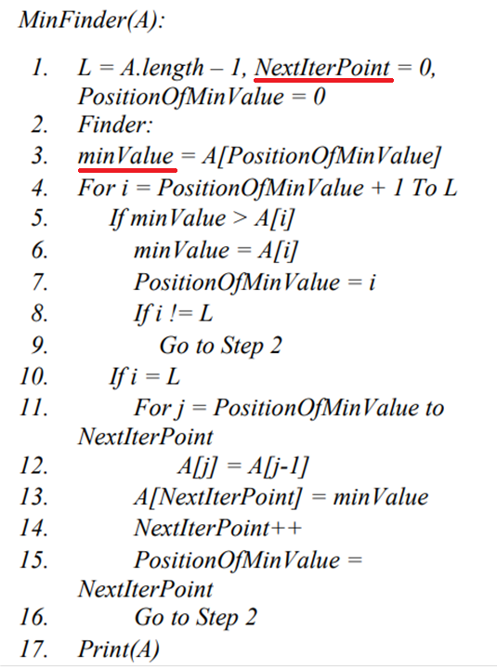
Pseudocode

Slide 13
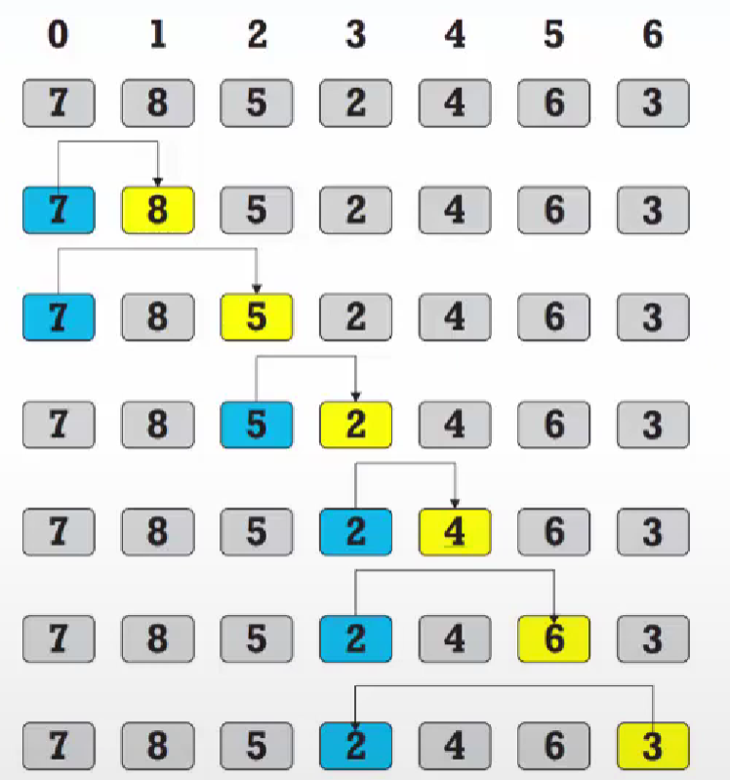
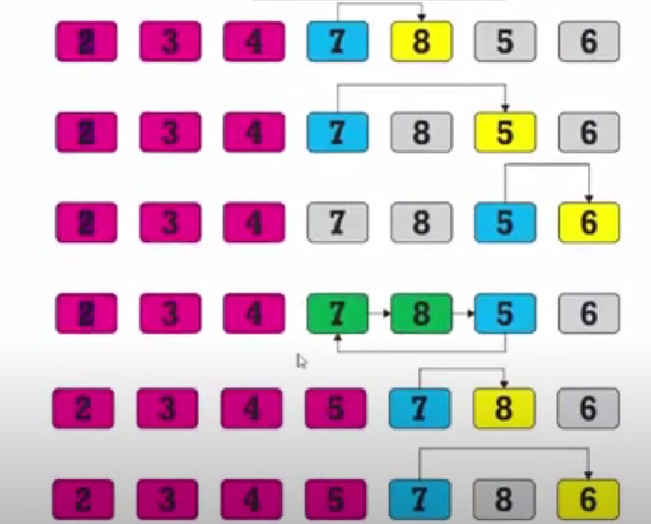
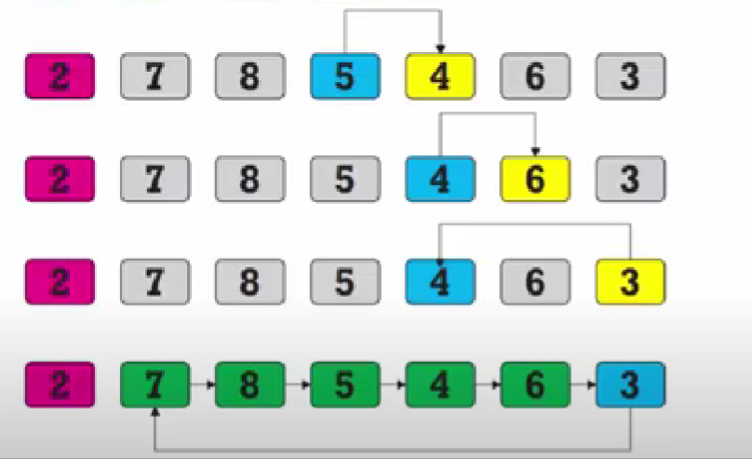
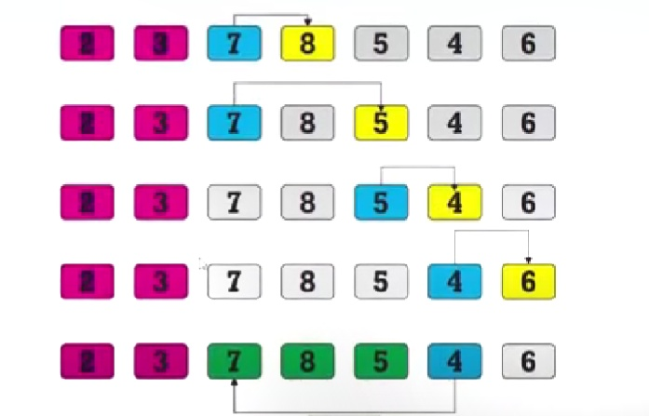
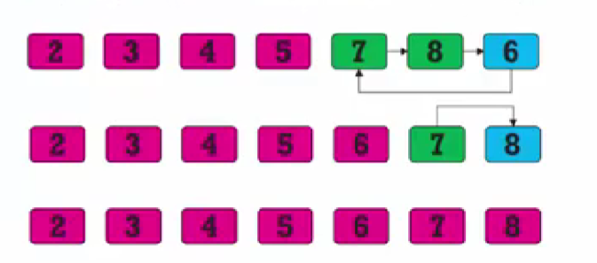
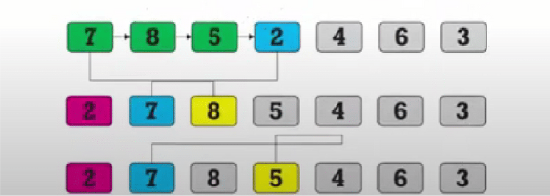

Slide 14
COMPLEXITY Analysis
The efficiency of any sorting algorithm is determined by the time complexity and space complexity of the algorithm.
Number of elements in array = n
To sort first element, the loop iterates for n-1 times.
To sort second element, the loop iterates for n-2 times .
Thus overall Time complexity = O(n^2)
Space Complexity = O(1)

Slide 15
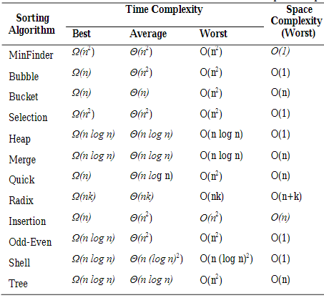
PERFORMANCE RESULT

Slide 16
CONCLUSION
This paper proposed a new technique for sorting algorithm, MinFinder, that is stable and in place sorting by reducing the memory consumption in conjunction with solving the sorting problem without any conventional swapping technique.
According to the time and space complexity analysis, MinFinder takes less time than some popular conventional sorting algorithms like Selection sort, bubble sort etc..

Slide 17
THANKYOU !

